Slide 1

Capstone - Predicting Airbnb Prices
Marta Huhoja
Institute of Data
January 2023

Slide 2

BIO
Bachelor of Educational Rehabilitation at the Faculty of Education and Rehabilitation Sciences, University of Zagreb
Master of Educational Rehabilitation at the Faculty of Education and Rehabilitation Sciences, University of Zagreb (Department of Inclusive Education and Rehabilitation)
experience in education, disability and the hospitality sector
Aspiring Data Scientist

Slide 3

Content
01
02
03
04
Introduction
Understanding the problem
Exploring Data
EDA, Feature Engineering
Modelling
Building machine learning models
Conclusion
Summary and next steps

Slide 4
01
Introduction
Understanding the problem

Slide 5

What is Airbnb
Airbnb began in 2008 when two designers hosted three travellers looking for a place to stay
free to use
provides unique stays, experiences and adventures
contributes to the local economy
Source: Deloitte Access Economics

Slide 6
Understanding the process
Specifying Problem
Obtaining Data
Exploring Data
Building Model
Interpretation

Slide 7
Understanding the Problem
Business value for hosts?
Which areas are more likely to have good prices?
How to establish competitive prices?
How can it be answered with data?
How does the price differ across Auckland?
What kind of property is most popular?
Can we predict/recommend in which price range should hosts put their property?

Slide 8
02
Exploring Data
EDA, Feature Engineering

Slide 9
About Data
Data is downloaded from http://insideairbnb.com/ - mission-driven project that provides data and advocacy about Airbnb's impact on residential communities
Data of all New Zealand listings as of 08/11/2022
39935 rows × 80 columns
Focus on Auckland and listings that currently have at least one review
Price higher than $20
At least one day available over the next 365 days and one review in the last month
4544 rows × 56 columns
Host, reviews, property, location, additional information

Slide 10
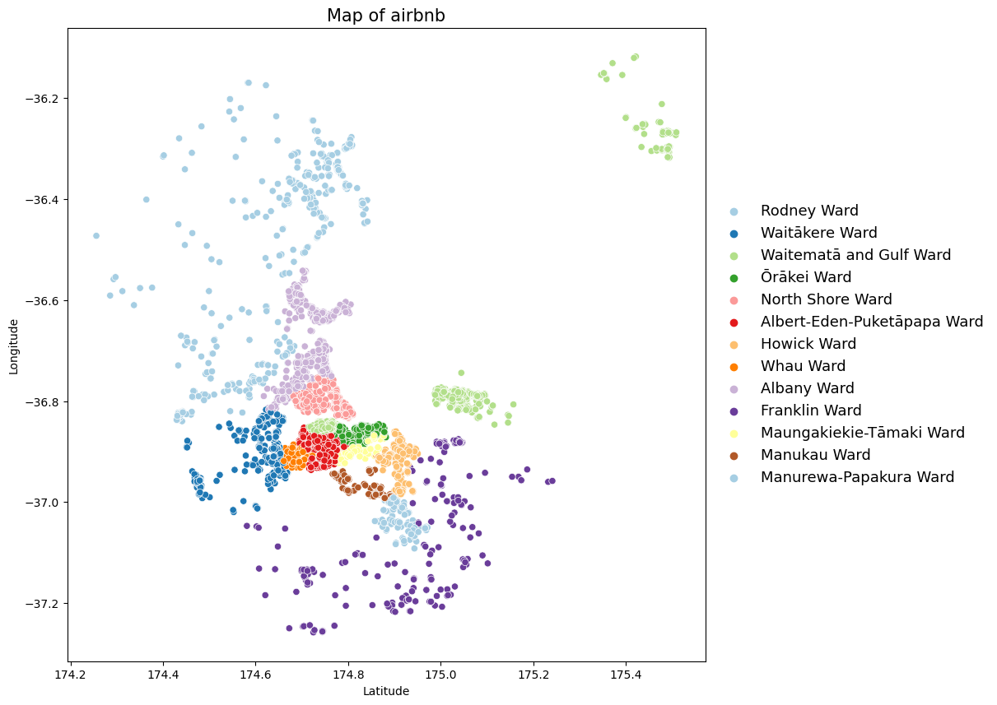
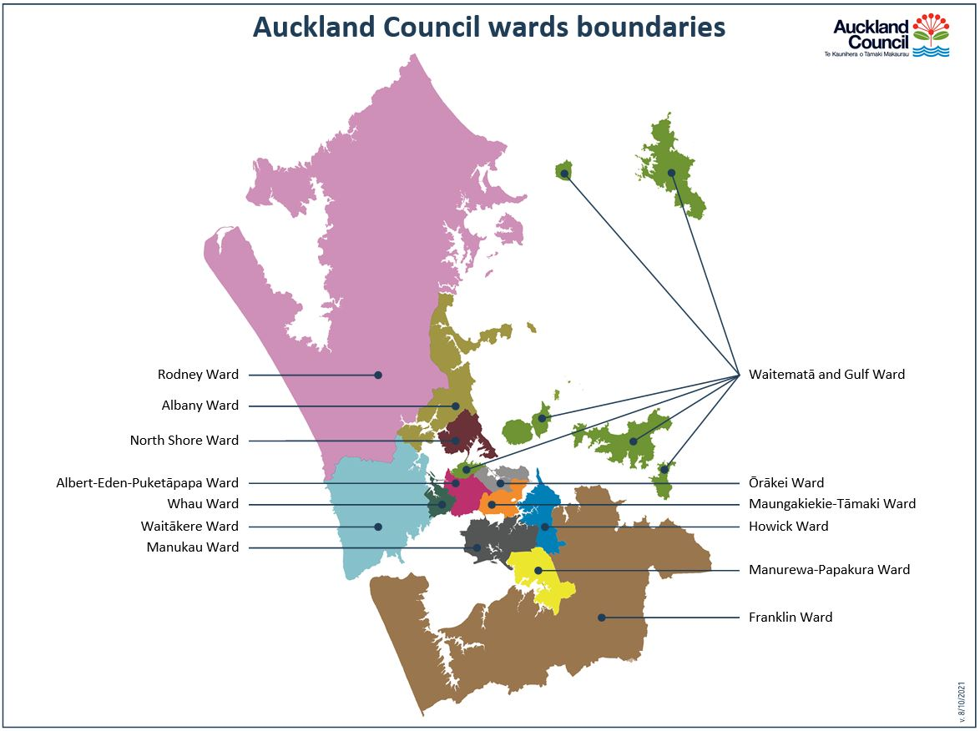
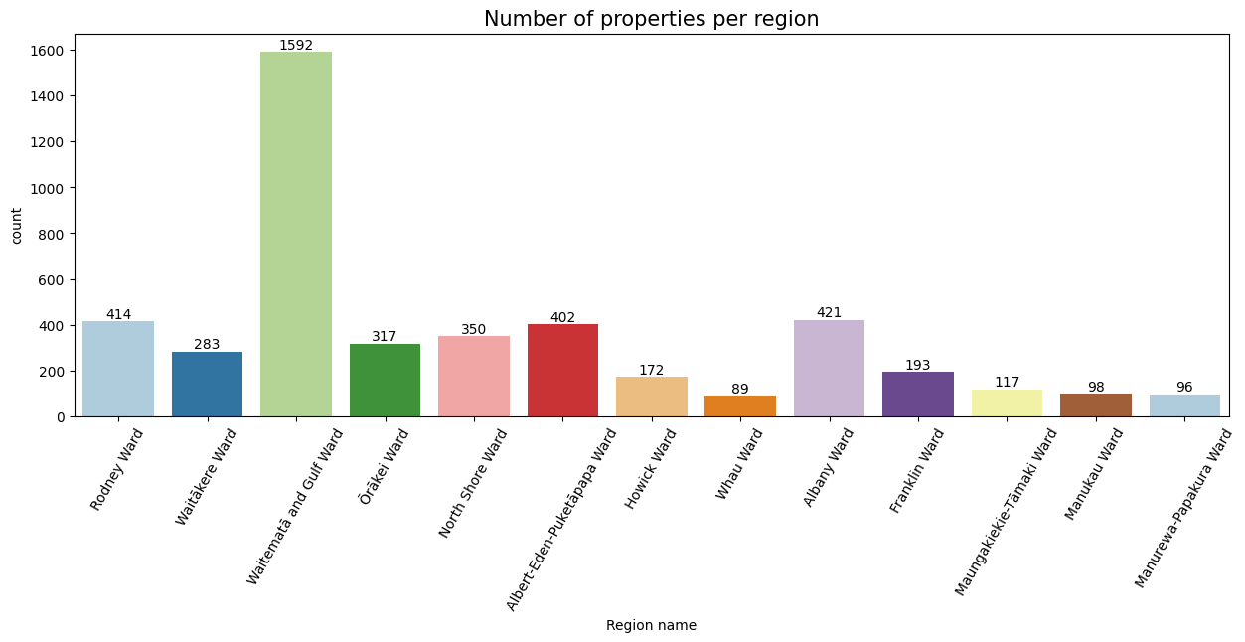

Slide 11
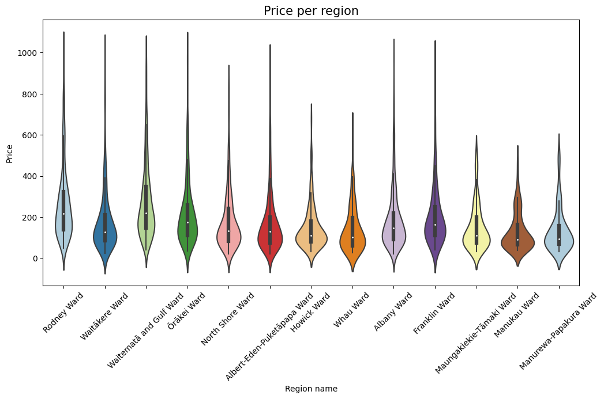
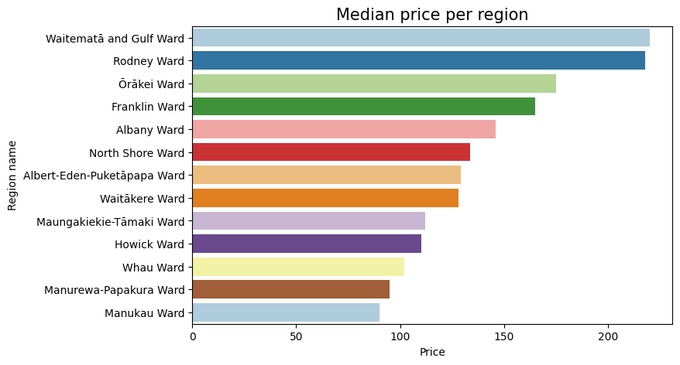

Slide 12
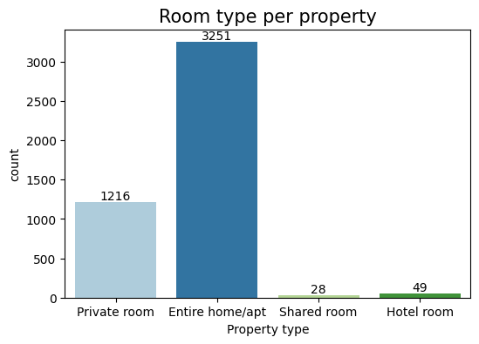

Slide 13
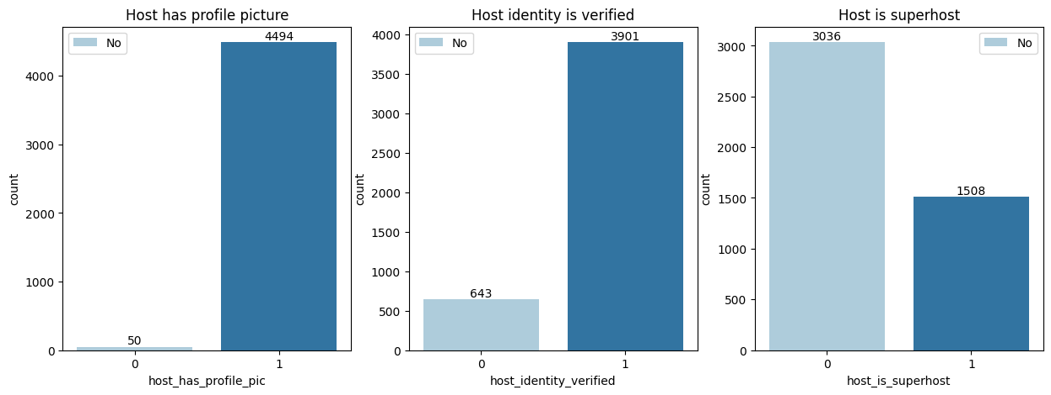
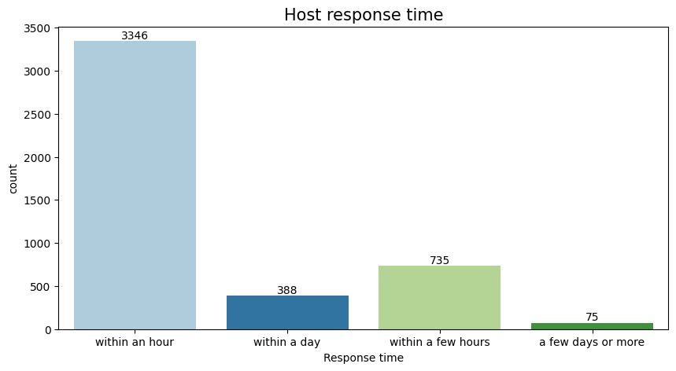
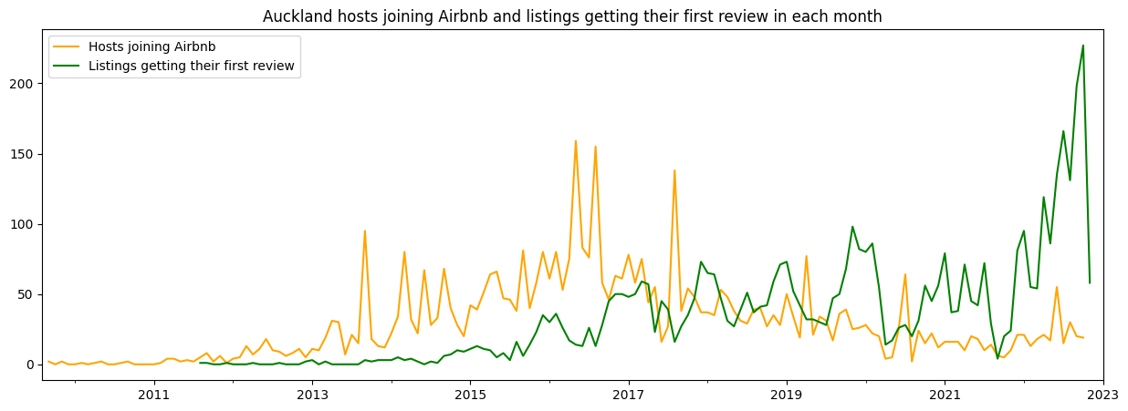
Host info

Slide 14
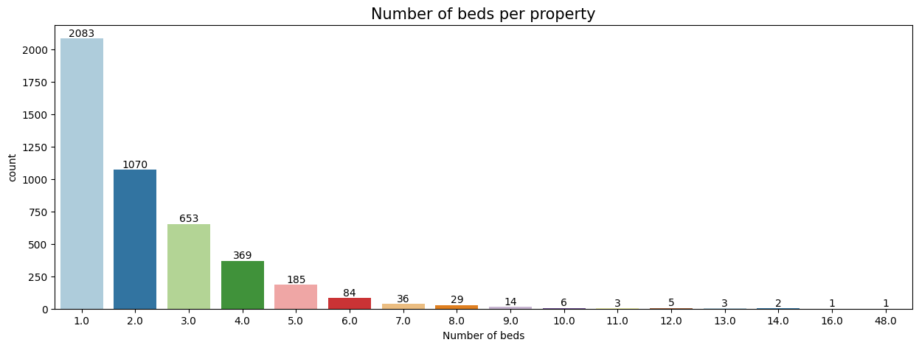
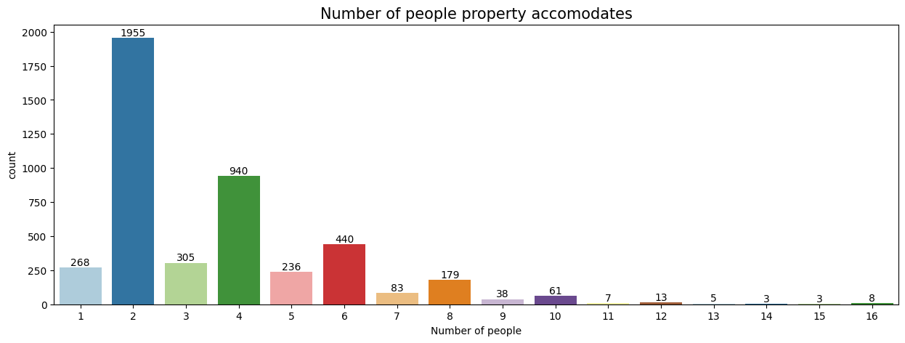
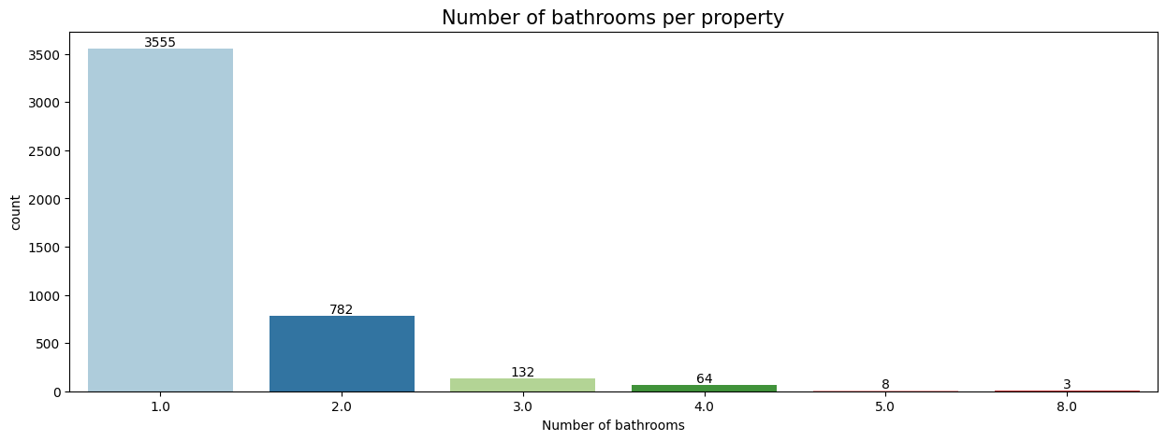
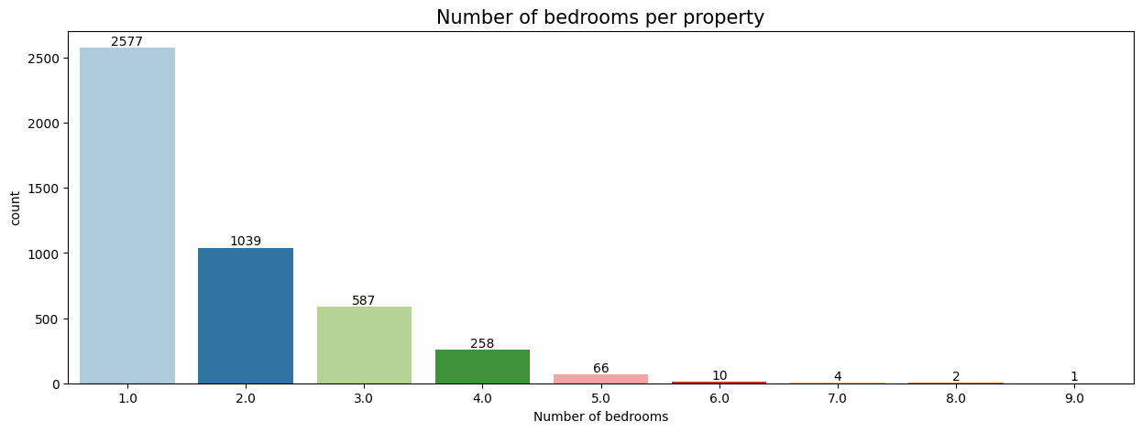
Property info

Slide 15
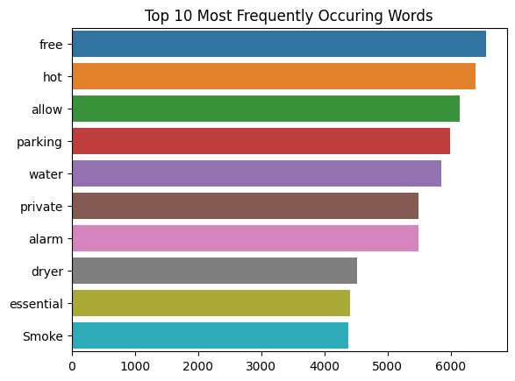
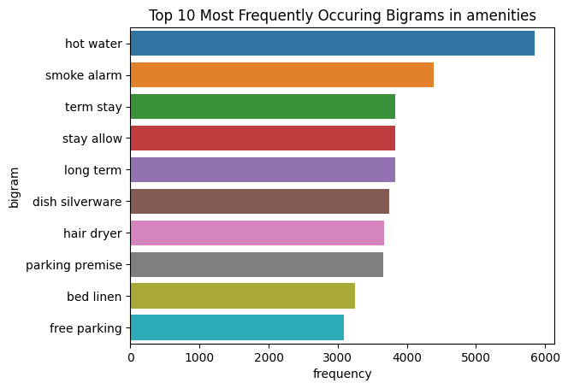
Amenities

Slide 16

Feature engineering
Price category
50 most frequent amenities split into categories - kitchen, personal, safety, household, bedroom, electronics, extra spaces
Host response time
Room type
Region name
Dropped columns with correlation < 0.01

Slide 17
03
Modelling
Building machine learning models

Slide 18
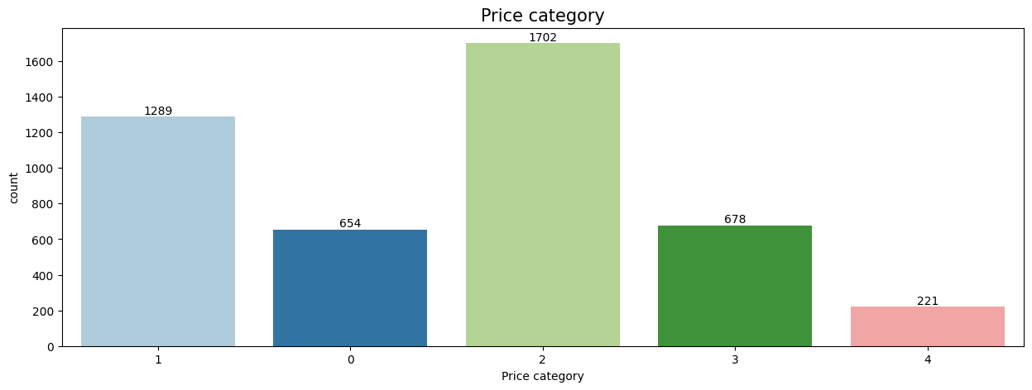
Target variable
- 0 - very low (< 80)
- 1 - low (80 <= value < 150)
- 2 - average (150 <= value < 320)
- 3 - high (320 <= value < 600)
- 4 - very high (>= 600)
Final data shape: 4544 rows, 49 columns

Slide 19
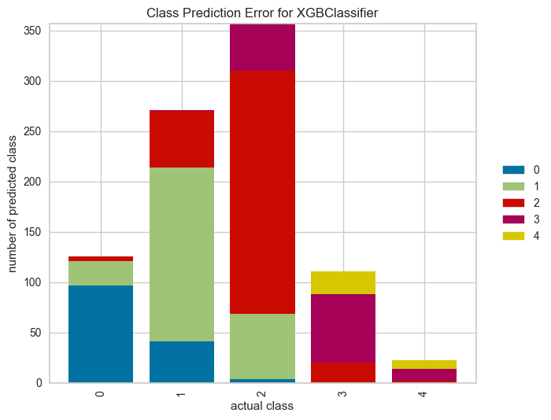
Models used/evaluation
Model: | Accuracy:
Decision Tree | 49.83%
K Nearest Neighbours | 53.14%
Support Vector Machine | 59.63%
Logistic Regression | 60.62%
Random Forest | 63.70%
XGBoost | 64.49%

Slide 20
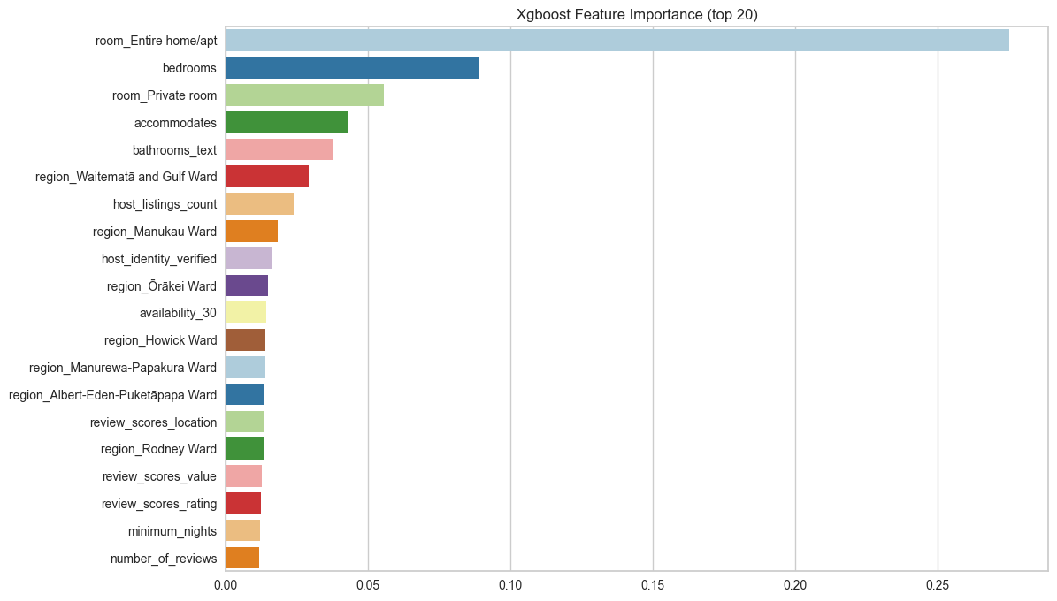
Feature importance

Slide 21
04
Conclusion
Summary and next steps

Slide 22

Region
Model and Future steps
Waitemata and Gulf Ward and Rodney Ward seem to have the highest median prices
Central Auckland, beaches, farms
XGBoost model has accuracy of 64.49%
Model can be deployed and application created that will help hosts determine the price
Text data (description)
Booking percentage (availability)
Property
properties that are rented out as a whole
Price is higher if property accommodate more people

Slide 23

Thank you!
Do you have any questions?

Slide 24
References
https://www.airbnb.co.nz/
https://docs.google.com/spreadsheets/d/1iWCNJcSutYqpULSQHlNyGInUvHg2BoUGoNRIGa6Szc4/edit#gid=1322284596
http://insideairbnb.com
https://www.aucklandcouncil.govt.nz/
https://news.airbnb.com/wp-content/uploads/sites/4/2018/05/dae-economic-contribution-Airbnb-new-zealand.pdf
https://www.dataquest.io/blog/machine-learning-tutorial/
https://coderzcolumn.com/tutorials/data-science/missingno-visualize-missing-data-in-python
https://github.com/L-Lewis/Airbnb-neural-network-price-prediction
https://github.com/alisonglazer/metis_project_5_airbnb_pricing
https://towardsdatascience.com/xgboost-for-multi-class-classification-799d96bcd368
https://www.sharpsightlabs.com/blog/pandas-get-dummies/

